Slide 1
Trustpoint.One

Slide 2
The Power of One.™
Everything you need. All in one place. With one trusted partner.

Slide 3
Total Support for the Entire Litigation Lifecycle.
TLS – Value Proposition – Why do clients purchase legal staffing/DH search recruiting services from TLS?
Discover.One eDiscovery, Forensic Data Collection, Hosting. Processing.
Review.One Managed Review, Legal Staffing Solutions.
.
Report.One Court Reporting, Videography, Transcription..
Translate.One Legal Translations,
Interpretations, Summary Reports.
LITIGATION LIFECYCLE
Talent.One | Legal Staffing.
Secondments and Legal Staffing Solutions for litigation and daily operations.

Slide 4
Discover.One
Finally, eDiscovery done right. Our client-centric solutions provide Managed Services & Custom Solutions for whatever your needs may be.

Slide 5
Managed Services: eDiscovery pricing has been broken for a long time. Our solution is simple: We align our interests with yours.
eDiscovery:
Managed Services
Simple Monthly Fee.
We agree together on an allotment of storage, processing, and project-management hours based on your specific needs. You just pay one, all-inclusive monthly fee. Simple.
Always Flexible.
All of our eDiscovery solutions are built-to-order. So, whether you need a little or a lot, you get exactly the right solution for your case. Pay only for what you need, get a whole lot more.
No Contract Required. Use your eDiscovery Solution only when you need it. If you go over your data allotment, we simply increase your bandwidth. No migration fees, in our out, ever.
Designed for You. Our project management always starts with a thorough analysis of your needs. Then we custom design each solution to address the unique requirements of your eDiscovery environment.

Slide 6
Custom Solutions: Powered by Relativity® –the world’s leading eDiscovery platform. Our custom-built, end-to-end solutions are flexible and built-to-order. .
eDiscovery:
Custom Solutions
Use a Little or a Lot. The flexible nature of our Custom Solution is designed to be user-friendly yet robust. Sometimes you need a bigger team and a full spectrum of support. Sometimes you just need help with a single piece. The beauty of our Custom Solution is that you just pay for what you need. If the situation changes, we change right along with you. Simple.
What Matters Most? Totally Up To You. When it comes to Project Management, it’s important to know what matters most to you right from the start. That way we can focus on what’s critical and map our way to winning your case. Our Project Managers address the entire spectrum of eDiscovery. We’re here to make life easy. We’re here to help you win.

Slide 7
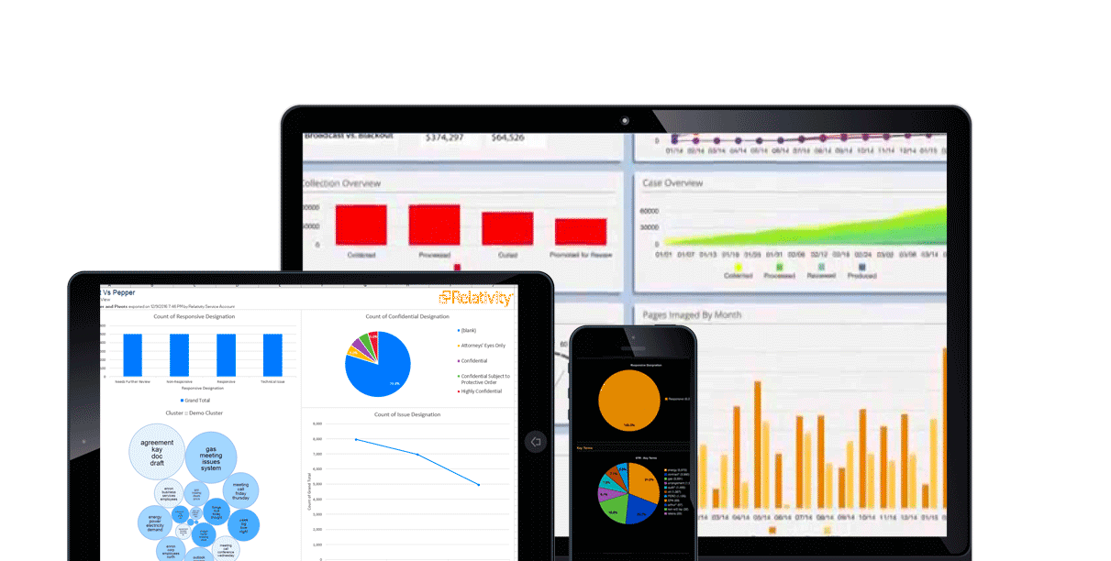
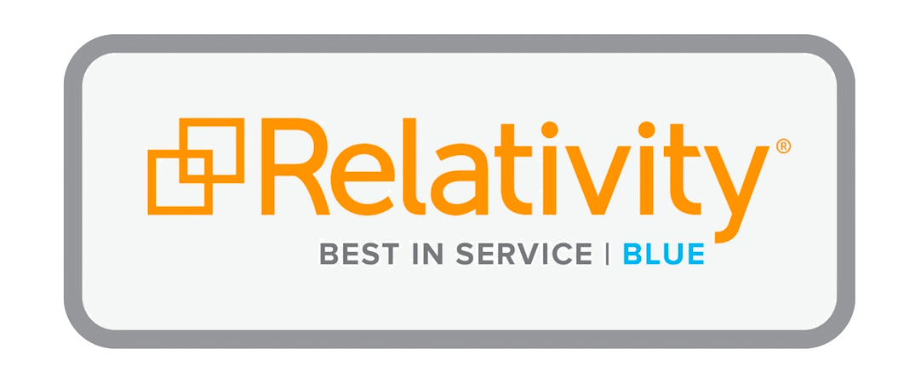
Custom Solutions: Powered by Relativity® –the world’s leading eDiscovery platform. Our custom-built, end-to-end solutions are flexible and built-to-order. .
eDiscovery:
Custom Solutions
Legal Hold: Forget manual, error-prone legal holds. Relativity brings defensibility and repeatability to the process.
ECA An early understanding of key information is one of the best ways to save time and money in eDiscovery.
Processing Relativity processing is the reliable way to get native files ready for review.
Review Everything you need for document review & production. We get you to the substance faster.
Analytics Bring Analytics into your workflow at any time, get investigative thought and a focused view.
Active Learning Technology-assisted review software helps you find your most relevant documents faster.

Slide 8
Review.One
Our Managed Review & Staffed Review solutions are driven by a relentless pursuit of efficiency.

Slide 9
Managed Review: We take a consultative, process-driven approach, leveraging proven strategy and best practices every step of the way.
Document Review:
Managed Review
Quality. We differentiate ourselves through the quality of our work, a reputation for transparency and our dedicated focus on review.
Defensibility. We start with the right people and add best practices and quality control. The result is a proven and repeatable process that can be applied anywhere, anytime.
Efficiency.
Our entire process is based on efficiency. From the people we hire to our dedicated review facilities – every step is optimized for the most efficient review process.
Cost Savings. Because we are specialists, it allows us to operate with efficiency – and efficiency leads to savings.

Slide 10
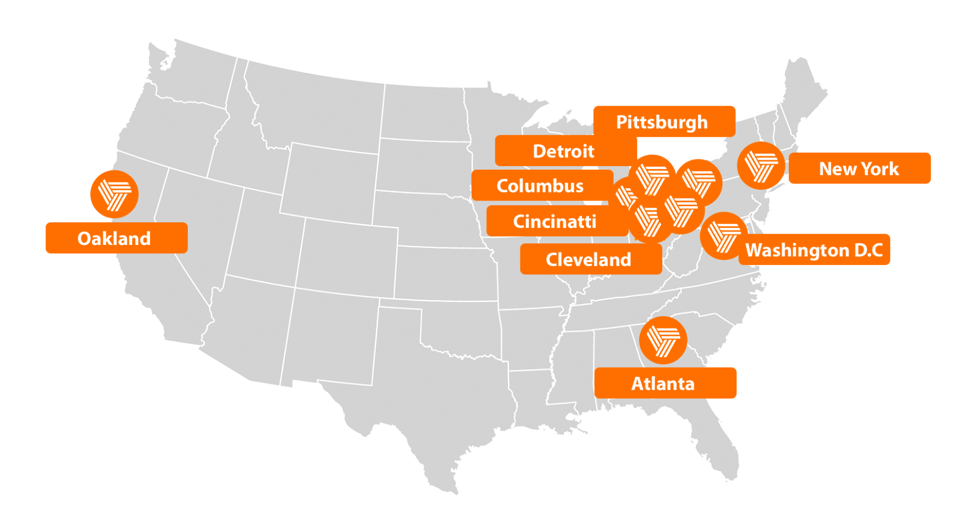
Staffed Review: With 9 dedicated review centers, we provide nationwide coverage.
Document Review:
Staffed Review
Purpose-Built Facilities.
Our facilities serve one function only – document review. We prioritize network and data security first.
A Deep Talent Pool.
Trustpoint has thousands of top review attorneys. We will assemble the right team with the right expertise for your case anytime, anywhere.

Slide 11
Report.One
Our Court Reporting Provides Reliable Staff & Peerless Technology.

Slide 12
Court Reporting: We choose our court reporters for their history of accuracy, customer experience and on-time delivery. Our next-level technology simplifies the entire process..
Court Reporting
Anytime, Anywhere.
We offer a full suite of court reporting and deposition services, delivered nationwide with next day service.
Managed on Mobile.
Our App features everything you’ll need to manage your reports, transcripts and depositions. So wherever you are, you’re always in full command.

Slide 13
Translations. Global Translation Solutions for the Legal Marketplace
Legal Staffing. Experts Providing Immediate Value.

Slide 14
Legal Translations: In a fast-paced global market, translations play a critical role. When you need absolute precision, delivered accurately and on time, Trustpoint.One delivers.
Translation
Legal Translations
In-depth Experience.
As one of the nation’s largest integrated legal solutions providers, we have the expertise to fully understand your legal challenges and the importance of legal translations. We have experience in an extensive range of matters, including FCPA/Bribery Act investigations, cross-border disputes, arbitrations, antitrust and patent litigation.
Priority Support. Our dedicated team of Project Managers will work closely with you to ensure that your translation needs are met, so you can focus on other aspects of your case. Backed by a certified quality-assurance program, we handle your documents with the confidentiality and expertise we know you expect.

Slide 15
Legal Staffing: Members of our recruiting, sales and leadership teams are experienced legal specialists. The quality of our placements reflects this expertise.
Legal Staffing
Legal Contract Staffing. Our vetted, top-tier contract workforce is available nationwide. As one of the nation’s largest full-service providers, we have the ability to staff up to 1,200 contract attorneys at any given time. Our process guarantees our team is ready to hit the ground running.
Permanent Placements. The Trustpoint Attorney Recruitment Team is aligned with the nation’s top legal professionals. Our customized approach to matching talent with opportunity has provided immediate value to our law firm and corporate clients, since 1987.

Slide 16
Priority Support
Customer support is a cornerstone of Trustpoint’s business. Every division and every solution is supported by a dedicated team that is here to make make your life easier.

Slide 17
Questions & Answers

