Slide 1
Technology in E-Discovery & Managed Review
Presented By Chris Lauer Trustpoint.One February 14th, 2018

Slide 2
Overview
Know the EDRM
Common pitfalls
Cost Control Strategies
Search Term Optimization
Efficient Review
Leveraging Technology
Case Studies
Practice Tips

Slide 3
Know the EDRM
Processing, Review & Analysis Represent 60-80% of Total eDiscovery Costs
Processing
Preservation
Information Management
Identification
Review
Production
Presentation
Collection
Analysis

Slide 4
The Importance of Efficient Review
These are the costs of Discovery by phase. Review is far and away the biggest driver.
73% Review

Slide 5
Common Pitfalls.
The 5 P’s
Understand the Data
Lack of Strategy
Search Term Testing
Primary Custodian Investigation
Linear Review
Leverage Technology

Slide 6
Strategies to Control Cost in Small Cases
Know your data early
Create test database
Leverage ECA / culling
Drive negotiations
Date limits
Limit custodians
Test prior to agreement
Prove burden
Test prior to agreement
.

Slide 7
Strategies to Control Cost in Small Cases
Custodian self collection Phase 1: custodians produce key documents Phase 2: sample test database to identify other documents Phase 3: ask other side to articulate why they need more in this case
.

Slide 8
Value of Planning
Plan ahead
Before litigation starts
Retention policy
Internal ECA tool
Client with these in place
Matter 1: $9,200
Matter 2: 17,700
Same industry & lit type
Matter 1: $423,000
Matter 2: $3.3 million
.

Slide 9
Cooperation Proclamation
Case Study 2 | Key Statistics
Type of matter | Commercial litigation
Original dataset | 1.20 million documents
Estimated original review cost | $1.2 million
Final dataset after optimization | 437,000 documents
Estimated final review cost | $399,500
Client savings $ | $800,500
Client savings % | 67%
What if you’re cooperating and they’re not?
Case study:
Test
Document
Propose solutions
Ask for a hearing

Slide 10
Understanding the Data
Case study:
Proportionality
Reasonable deadlines
Hard data on burden
Use test database
Break down cost
Extrapolate for all custodians
Reviewing 1 terabyte: 50 people, 60 docs/hr, 1 year

Slide 11
Preparation
Can your client search data in place? If not, create a test database with key custodians
Leverage ECA tools
- Date limits - Custodian limits - Domain filtering - Documentation

Slide 12
Search Terms
.
Purpose:
Find needles
Smaller haystacks
Control costs
Win your case
Search terms:
Who is developing them?
Who is using them?

Slide 13
Search Term Optimization
Draft terms
Test terms
Prioritize
Sample
Identify false hits
Suggest limiting logic
Iterate and document Why? In re Fannie Mae Sec. Litig., 552 F.3d 814 (D.C. Cir. 2009)

Slide 14
Search Term Logic: Example .
Include: “DME Product” “DME w/2 Group”
Both Entities
Exclude: “DME Specialty”
Proposed term: “DME” – Disposable Medical Equipment
Client: DME Product Group
Non-relevant entities: DME Specialty Co. Premier DME, LLC
All
DME as alias for relevant entity
DME as alias for non-relevant entity
Generic reference “DME”

Slide 15
Search Terms Testing .
Keyword Documents 841,897
Judicial Encouragement is strong for carefully crafted search terms
Custodian Input
Quality Control Tested
Tested Before Agreement
Responsive Set 108,914
Total Items 1,575,337

Slide 16
Search Terms Testing .
Run draft terms in test database
Prioritize (most to least hits)
Review sample of first term
Tag relevant documents
Tag relevant hits
Identify top false hits
Revise search terms & retest
Inclusion logic (“and” “w/20”)
Exclusion logic (“not”)
Iterate to optimize
Document process

Slide 17
Search Methodologies for Smaller Cases .
Use proportionality
Amount of data in controversy
Significance of the case
Search data in place or leverage a small test database
Limit custodians & date range
Use domain filtering

Slide 18
Search Term Testing Testing Reduces Cost Dramatically
Case Study 1 (S1.12M SAVED) | Key Statistics
Type of matter | Government subpoena
Original dataset | 1.34 million document
Estimated original review cost | $2.51 million
Final dataset after optimization | 741,000 documents
Actual review cost | $1.39 million
Client savings $ | $1.12 million
Client savings % | 45%
45% Cost Savings
Case Study 2 ($800k SAVED) | Key Statistics
Type of matter | Commercial litigation
Original dataset | 1.20 million documents
Estimated original review cost | $1.2 million
Final dataset after optimization | 437,000 documents
Estimated final review cost | $399,500
Client savings $ | $800,500
Client savings % | 67%
67% Cost Savings

Slide 19
Review Efficiently
Process & project management
Quality control
Reporting
Privilege Review
Leadership

Slide 20
Workflow Diagram
Outside Counsel
Client
Litigation Counsel
Review Tool Provider
BLD Relationship Manager
Review Team 1
Review Team 2
Review Team 3
Discovery Consultant
Discovery Consultant
Discovery Consultant
Review Team
Review Team
Review Team
QC Team
QC Team
QC Team
Outside Counsel QC Process
Production

Slide 21
Quality Control
Integrated w/ Client QC
Round robin QC
100% QC
Statistical sampling QC
95% confidence interval
2% margin of error
Targeted QC & Cleanup
TAR: amplification effect

Slide 22
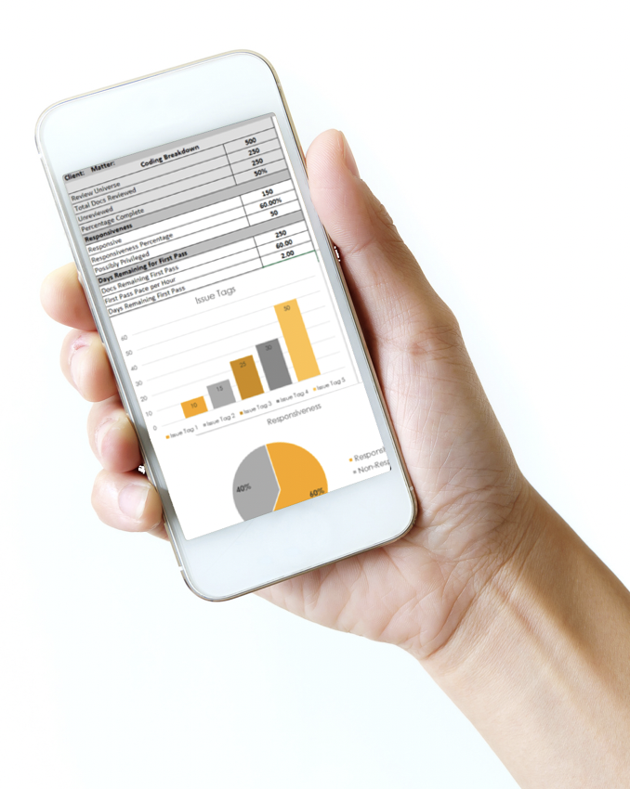
Decision Log & Daily Reporting
Documentation of evolving guidance from Outside Counsel
Reporting of Review Team progress and pace
Diary of Project Activities

Slide 23
Privilege Review Best Practices
Review protocol memo
Training on privilege
First level privilege review
Second level privilege review
Multi-layered quality control process

Slide 24
Privilege Review Best Practices: Mechanics
Pick lists, check boxes and radio buttons for common phrases
Type only when necessary
Add typed entries to common phrases
Case study: improved efficiency, better uniformity and reduced QC prior to production

Slide 25
Privilege Review Best Practices: Substance
Metadata (To, from, cc:, date)
Type of communication (Email)
Parties to communication (Client personnel and counsel)
Claim of privilege (Reflecting legal advice)
Subject of communication (Regarding contract litigation)

Slide 26
Privilege Review Best Practices: Issues
Open question: logging each email in an email chain?
This is rarely done in practice. Typically log top level email & name legal personnel in log entry if not in metadata
Challenge: Manually entering metadata for underlying emails may exponentially increase amount of logging required

Slide 27
Leveraging Technology: TAR
Predictive Coding/Ranking
Computer Assisted Review
Technology Assisted Review
Machine Learning

Slide 28
TAR Defined.
“A family of technologies and applications that receive input such as coding decisions from human beings for a small subset of documents and use computer algorithms that leverage those human decisions to infer a reliable method to help categorize, code or rank the remaining ESI in the set”
- 17 Rich J.L. & Tech 9 at 25-26 (2011)

Slide 29
TAR: How it Works
Tool acquires a small representative cross-section of the documents, sometimes referred to as a “seed set.”
Subject matter experts review seed set
Based on the designations/tags decision made by the subject matter experts an algorithm assigning predictions to additional documents in the database.

Slide 30
TAR: Cutting Volume & Cost
Simple Text Highlighting
Bulk Tagging
Data Volume
Quality Control
99.9% Confidence

Slide 31
TAR: Why is it Necessary?
Data volume adds up incredibly quickly.
One typical computer holds roughly 5 million documents. Or 100 gigs of data.
Ten computers hold roughly 50 million documents. Or 1 TERABYTE of Data.
It would take a team of 50 people an entire year to review a single TERABYTE of data.

Slide 32
TAR: Conceptual vs. Linear Review
Time
Document Decisions Per Hour
Document Decisions Per Day
Total Document Decisions Per Hour
Total Hours Required for Review
Hours to Complete Review
Days to Complete Review
Concept
250
2,000
1,250
4,514
903
112.9
Linear
40
320
200
16,929
3,386
423.2

Slide 33
Predictive Coding: Explained
Predictive coding is a very powerful tool, but it has its flaws. It has a known overfit problem, and it can see relationships where they don’t exist.

Slide 34
Concept Search & Clustering
What is concept search?
“Sugar” finds “Sweetener”
What is concept clustering?
Analysis of terms in context. For “diamond”, do you want baseball or jewelry?
Custodian clustering
Who is talking to whom?
Near duplicate analysis

Slide 35
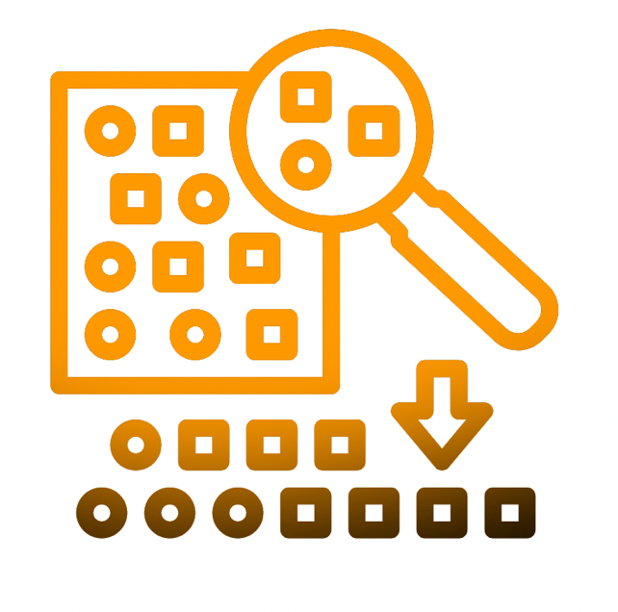
Statistical Sampling
Statistical Significance & Sample Sizes
Raosoft calculator
Why random sampling?
Confidence Interval
Measures uncertainty
95% is emerging baseline
Margin of Error
Measures error
2% is emerging baseline

Slide 36
The Power of Statistical Sampling
20,000 documents Sample: 2,144 documents
2 million documents Sample: 2,399 documents
3 million documents (Da Silva Moore) Sample: 2,399 documents
20 million documents Sample: 2,401 documents

Slide 37
Thank You.
Chris Lauer Senior Director 202.316.5700 chris.lauer@trustpoint.one

